Slide 1
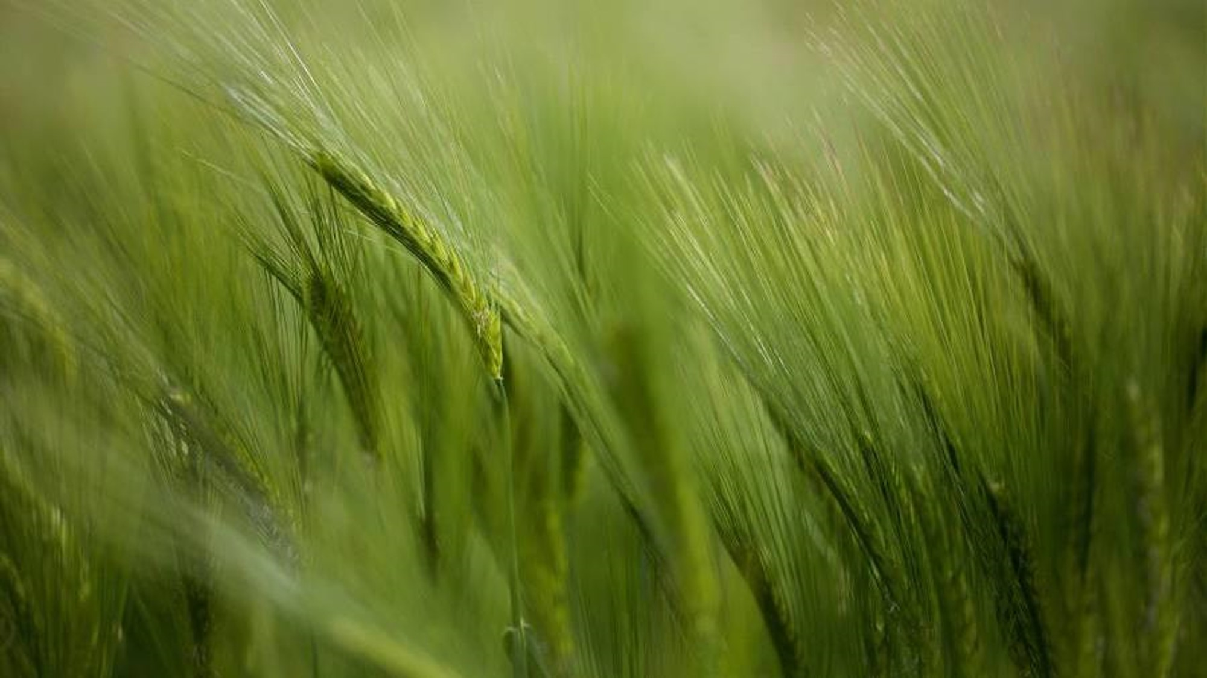
Crop Yield Prediction
Batch : 2023-10387
Harshali Sunil Bhopale :(EBEON0923841166)

Slide 2
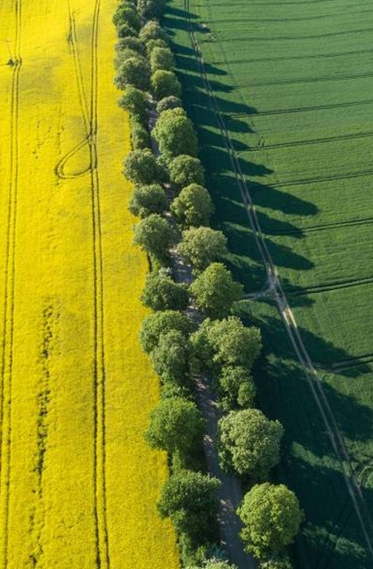
Problem Statement
To develop a precise machine learning model.
Empower farmers with accurate predictions.
Efficient Resource Allocation.
Optimize Fertilizer, Water, and Labor Usage.
Mitigate Risks from Adverse Weather and Pests.

Slide 3
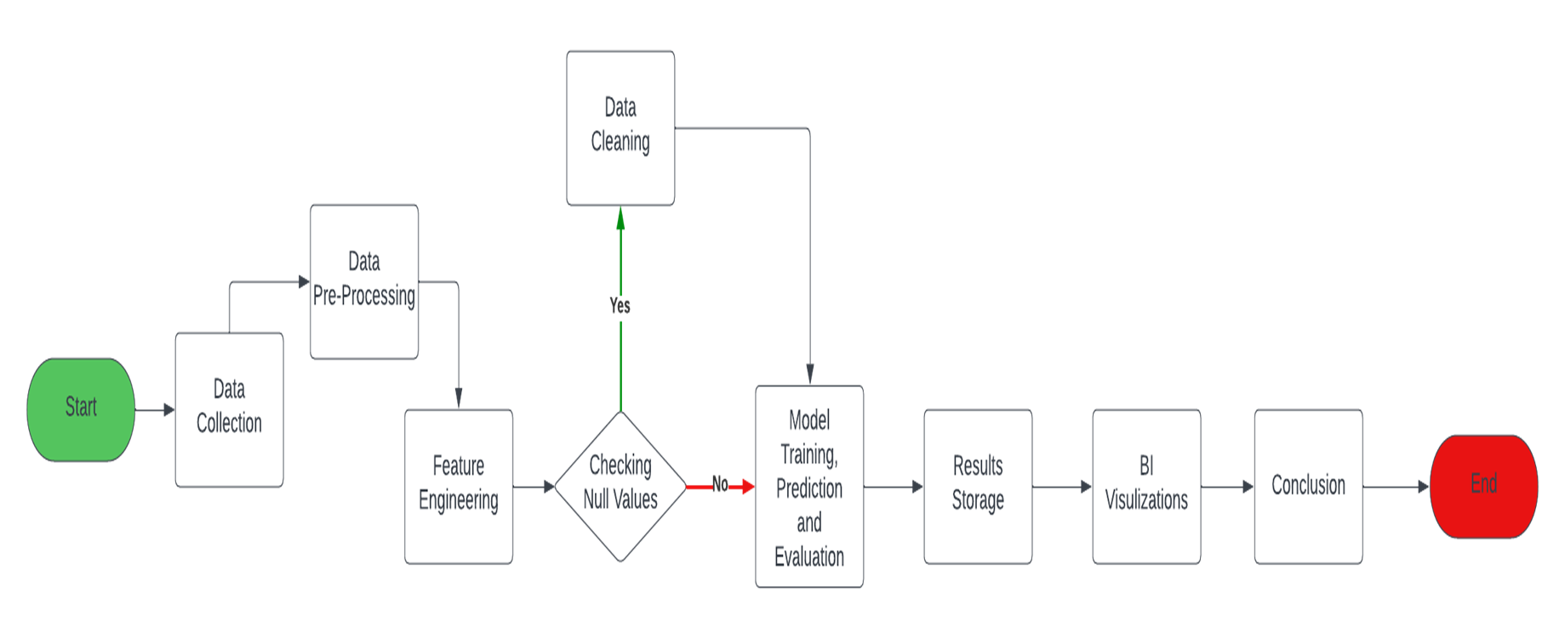
Architecture

Slide 4
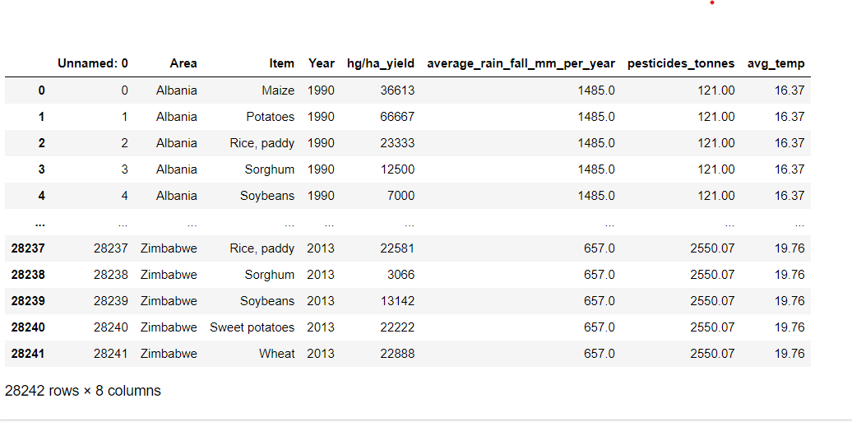
Dataset

Slide 5
Overview
Data Size: 28242 rows × 8 columns.
Null Values: 0.
Duplicates: 2310.
Categorical : 2 feature.
Numerical : 5 features.

Slide 6
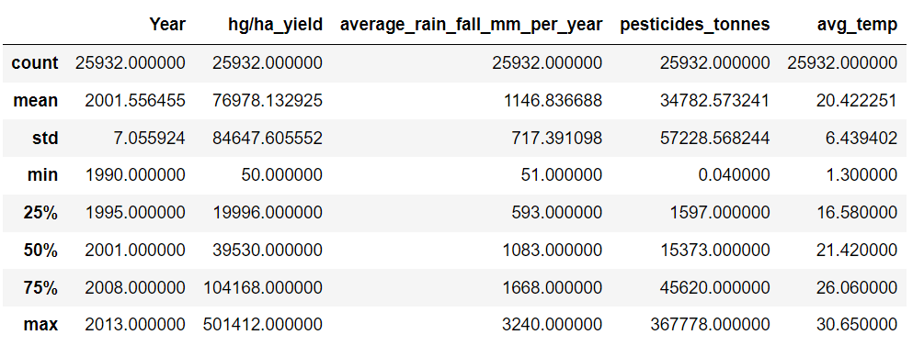
Statistical Summary

Slide 7
LinearRegression
Lasso
Ridge
KNeighborsRegressor
DecisionTreeRegressor.
Models used
DecisionTreeRegressor.
K-Nearest Neighbors Regression.
Best Suitable Algorithm

Slide 8
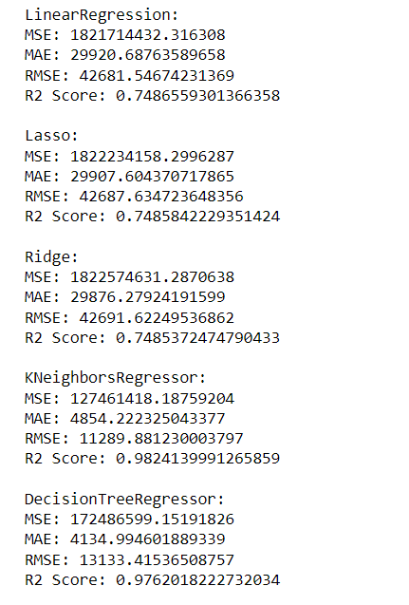
Accuracy

Slide 9
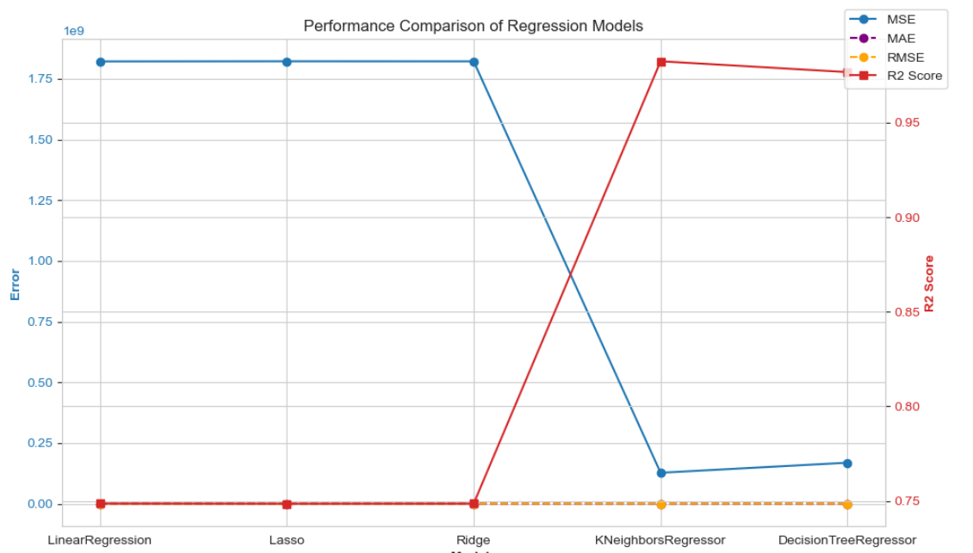
Prformance comparison of regression models

Slide 10
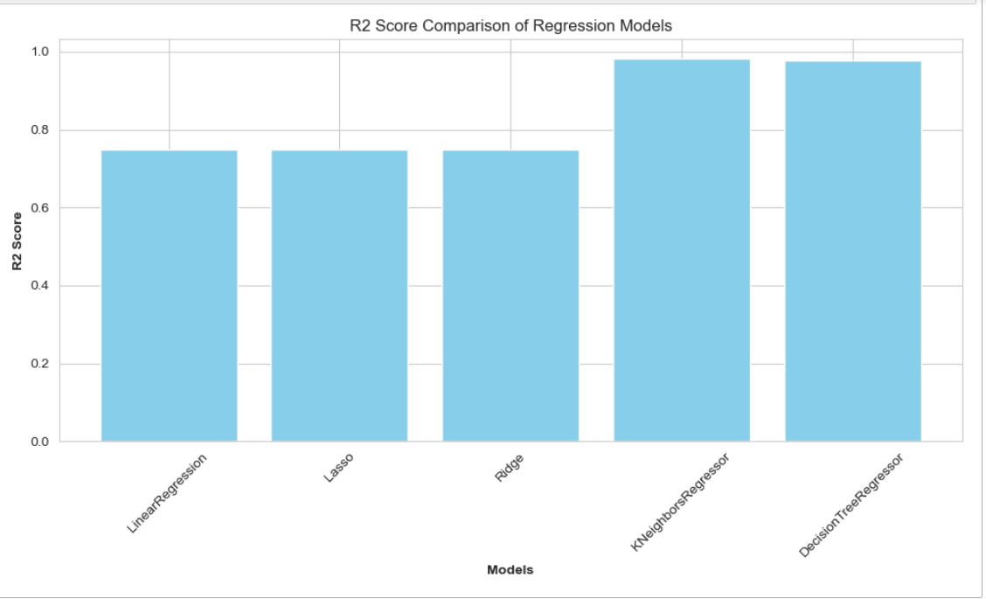
R2 score comparison of regression models

Slide 11
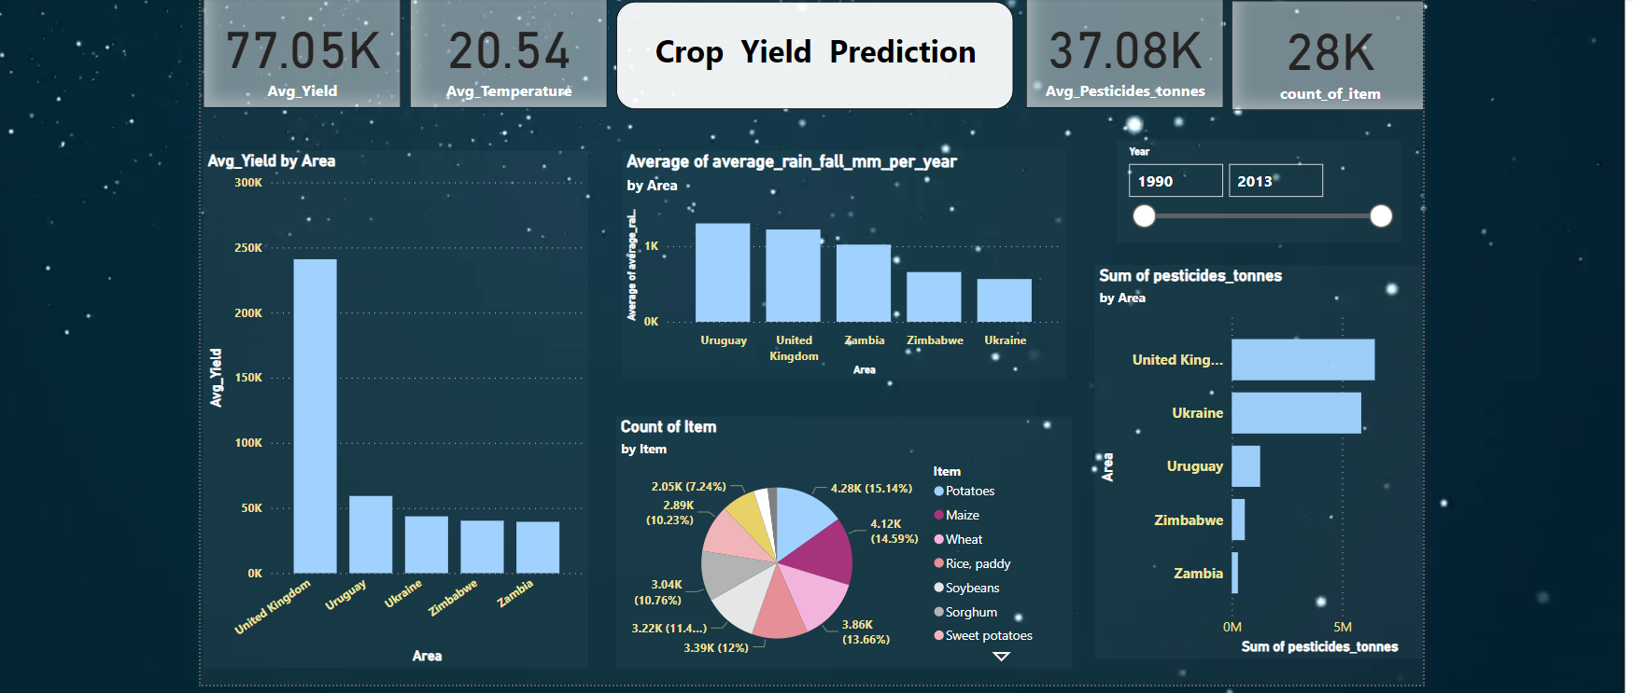
Dashboard

Slide 12
Conclusion
Based on the results of the crop yield prediction models:
The k-nearest neighbors regression (knr) and decision tree regression (dtr) models demonstrate superior performance.
These models offer improved precision and reliability.
Enabling farmers to make informed decisions.
And optimize agricultural practices for enhanced productivity.

Slide 13
Future scope of project
Future scope of crop yield prediction project:
1. Advanced model development:
- Enhance model robustness and scalability.
2. Integration of additional data sources:
- Incorporate remote sensing imagery and iot sensor data.
3. Real-time decision-making platforms:
- Develop predictive analytics tools accessible to farmers.
4. collaboration with agricultural experts:
- Partner with experts to tailor models to diverse crop types, regions, and farming practices.

Slide 14

Thank you

